Slide 1
CSE 4128 labtest
Instructors:
Dr. Sk. Md. Masudul Ahsan Professor,
Dept. of Computer Science and Engineering, KUET
Mr. Sunanda Das
Assistant Professor,
Dept. of Computer Science and Engineering, KUET

Slide 2

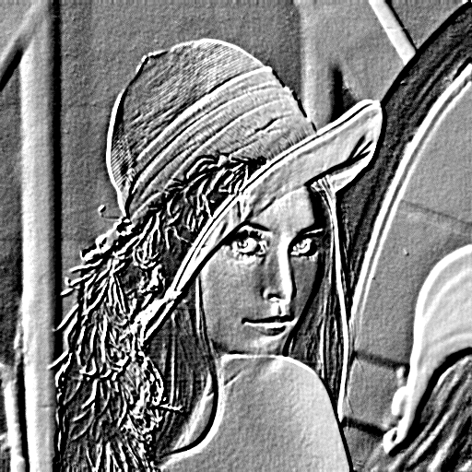
Problem 1
-2 | 0 | -1 | 0 | 0
0 | -2 | -1 | 0 | 0
-1 | -1 | 1 | 1 | 1
0 | 0 | 1 | 2 | 0
0 | 0 | 1 | 0 | 2
Convolve the following Lena image by the given kernel
Encircled cell shows the center of the kernel
Kernel
Input
Sample output

Slide 3
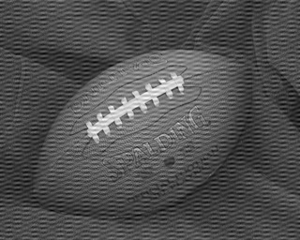
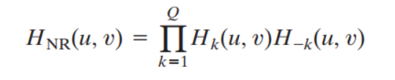
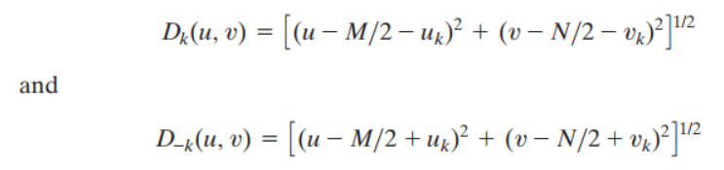
Problem 2
Remove the noise from the following image using ideal notch filter.
Supplementary material:

Slide 4
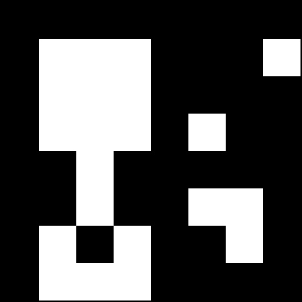
Problem 3
Use hit or miss transformation on the image and find object M.
Object M
Size: (50×50)
A B = (A Ɵ B₁ ) ∩ (A^{C} Ɵ B₂)
*

Slide 5
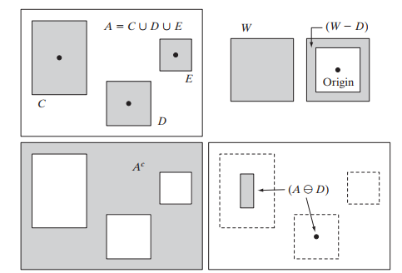
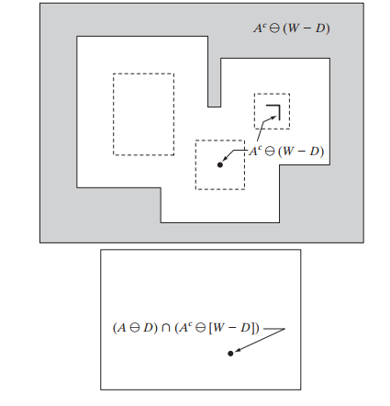


Supplementary material for problem 3
If B1 = D, B2 = (W - D) then

Slide 6
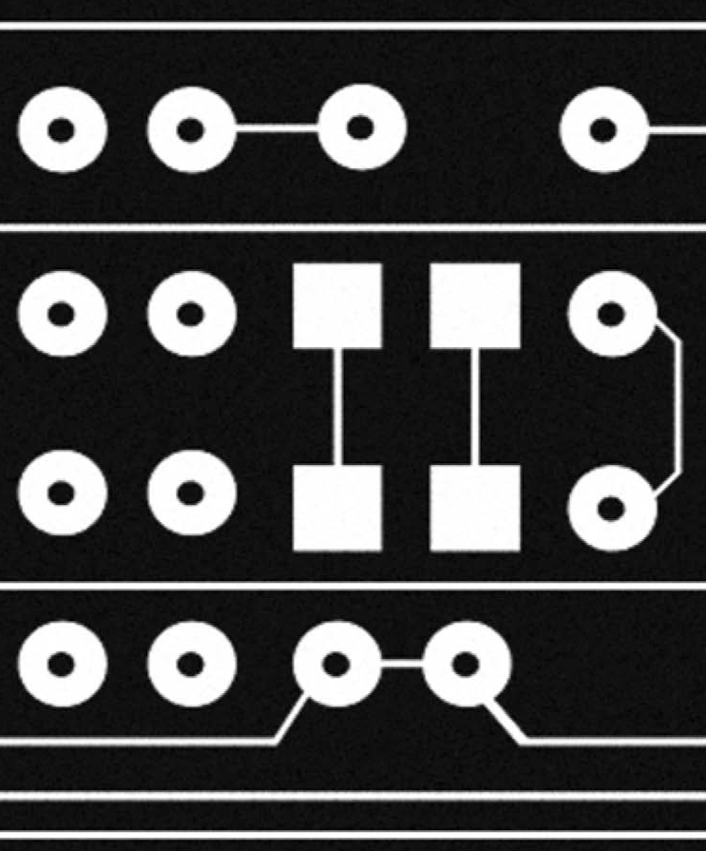

Problem 4
Fill up the hollow region using hole filling algorithm.

